Slide 1


Slide 2
Guitars Go Electric

Slide 3
Lesson Objectives
Describe the terms loud and soft as they pertain to music.
Differentiate between an acoustic guitar and an electric guitar.
Analyze sound possibilities through creative thinking and shape recognition.
Create an electric guitar drawing with a body, strings, pickup, and tuning pegs using any color or shape of their choice.

Slide 4
Today, we are going to be talking about guitars!
In each of the following slides, decide which
guitar you think is louder and explain why. ​

Slide 5
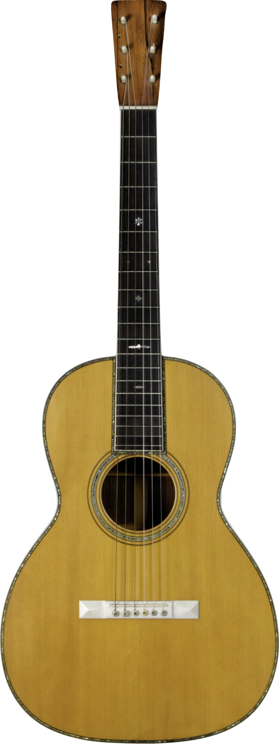
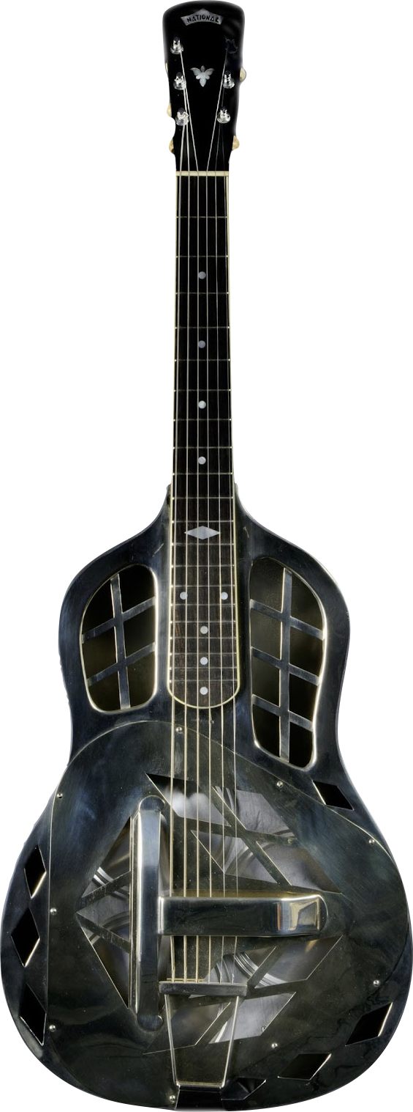
Which is louder?
Why?
Notes:
The resonator guitar is louder because of the material it’s made of as well as the resonator cones inside that help project the sound.
C.F. Martin & Co. 00-42 Parlor Guitar, 1902
The 00 body type, known as the Grand Concert, was the largest instrument available from C.F. Martin through the early 20th century but is now among the smallest. The second part of the model name, in this case 42, refers to the instrument's style, or level of appointment. Style 42 was, at the time, the top of Martin's line and featured pearl inlay, ivory components, and an ebony fingerboard. The two additional holes on the headstock of this instrument indicate that it had previously been adapted for use with eight strings.
National String Instrument Company Spanish-Style Resonator Guitar Prototype, 1926-7
In the 1920s, vaudeville steel guitarist George Beauchamp asked inventor John Dopyera to devise a way to amplify the sound of a guitar. Dopyera experimented with placing resonating cones in the body of the instrument, and in 1927 he and Beauchamp were making resonator guitars with Hawaiian-style bodies under the name National String Instrument Company. This example, made of nickel silver, was National's first prototype guitar with three resonators. Its Hawaiian-style square neck was replaced with a Spanish-style one at the request of guitarist Waltimor Shablowski, and it subsequently became the prototype for National’s Spanish-style resonator guitars.
The resonator guitar is louder because of the material it’s made of as well as the resonator cones inside that help project the sound.

Slide 6
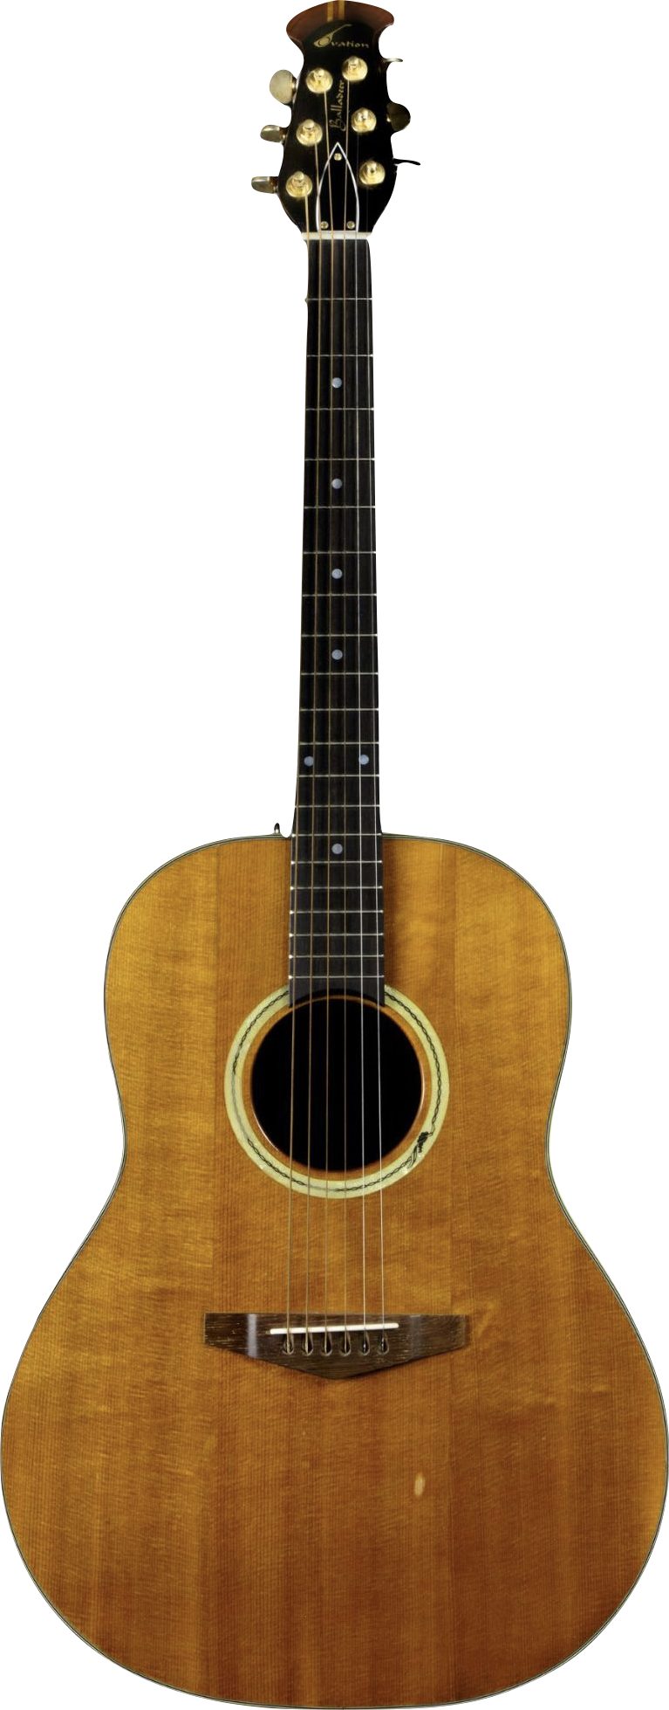
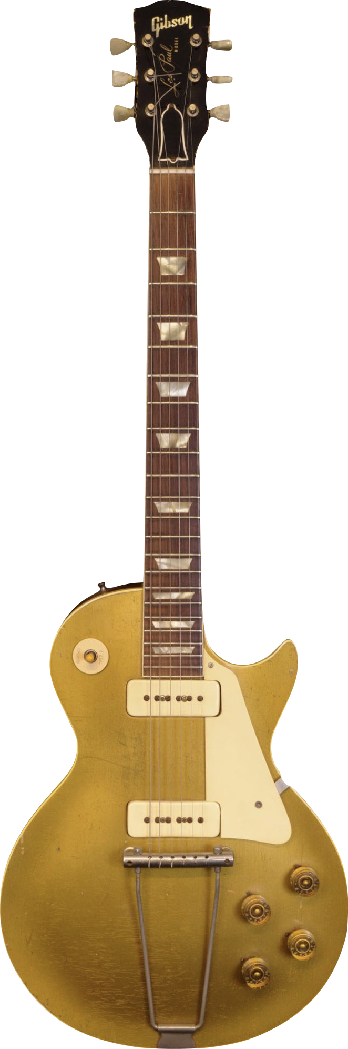
Which is louder?
Why?
Notes:
This slide is tricky: Since the picture does not include an amplifier, the acoustic guitar would be louder in this case.
Ovation Instruments Balladeer Guitar, 1968
In 1966, helicopter engineer Charles Kaman and the Ovation Guitar Company released their first guitars. These featured a parabolic bowl-shaped back made from Lyrachord, a form of fiberglass based on materials used in helicopter rotors and other aerospace components, giving them noticeably more volume than comparably sized all-wood guitars.
Gibson, Inc. Les Paul “Goldtop” Electric Guitar, 1952
Pioneering guitarist Les Paul had developed his own solid-body electric guitar, “The Log,” in 1940. He approached Gibson in 1941 about bringing it to market, but it wasn’t until Fender’s success with the Telecaster that Gibson acted. With a promotional deal in place, the Gibson Les Paul guitar was released in 1952. Together, the Telecaster, Stratocaster, and Les Paul have come to represent archetypal forms of the electric guitar, inspiring countless subsequent instruments.

Slide 7
What is the difference between an
"acoustic" guitar and an "electric" guitar?

Slide 8
Acoustic Guitar
In order for a sound to be heard, there must be vibration.
When a musician plucks or strums the strings of the guitar, the strings vibrate. The air inside the hollow guitar body causes the top of the guitar to also vibrate. This allows the sound to be heard. The sound hole allows the vibrating air inside the instrument to travel outside, which lets the guitar be heard even more.
Notes:
Ovation Instruments Balladeer Guitar, 1968
In 1966, helicopter engineer Charles Kaman and the Ovation Guitar Company released their first guitars. These featured a parabolic bowl-shaped back made from Lyrachord, a form of fiberglass based on materials used in helicopter rotors and other aerospace components, giving them noticeably more volume than comparably sized all-wood guitars.

Slide 9
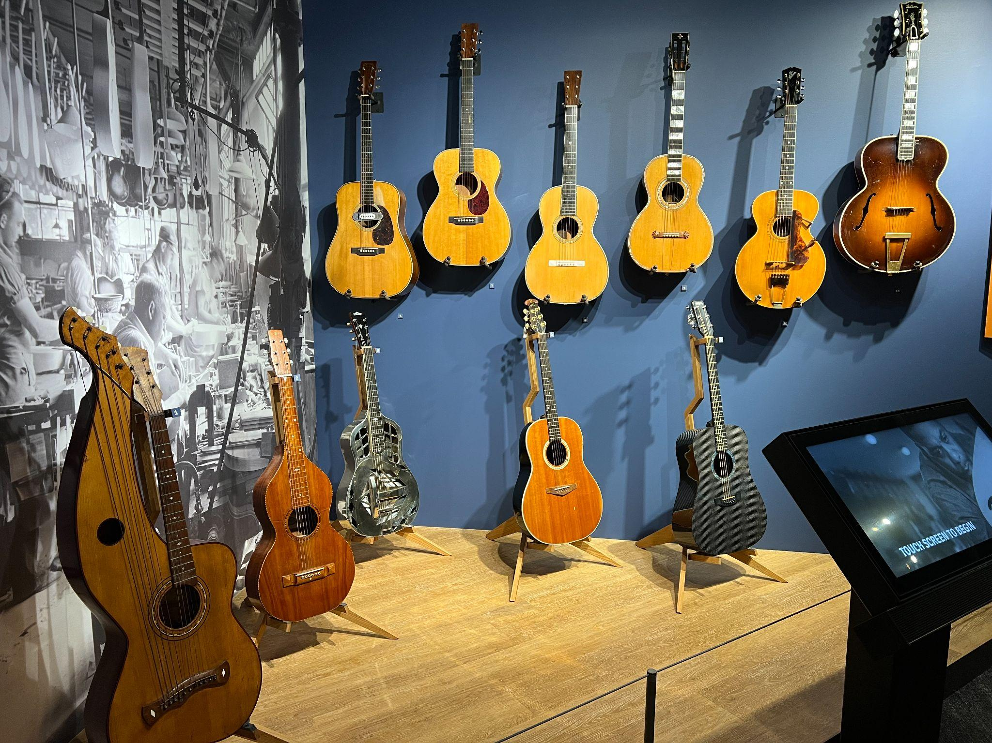
These are
acoustic guitars
from the
Museum of Making Music!

Slide 10
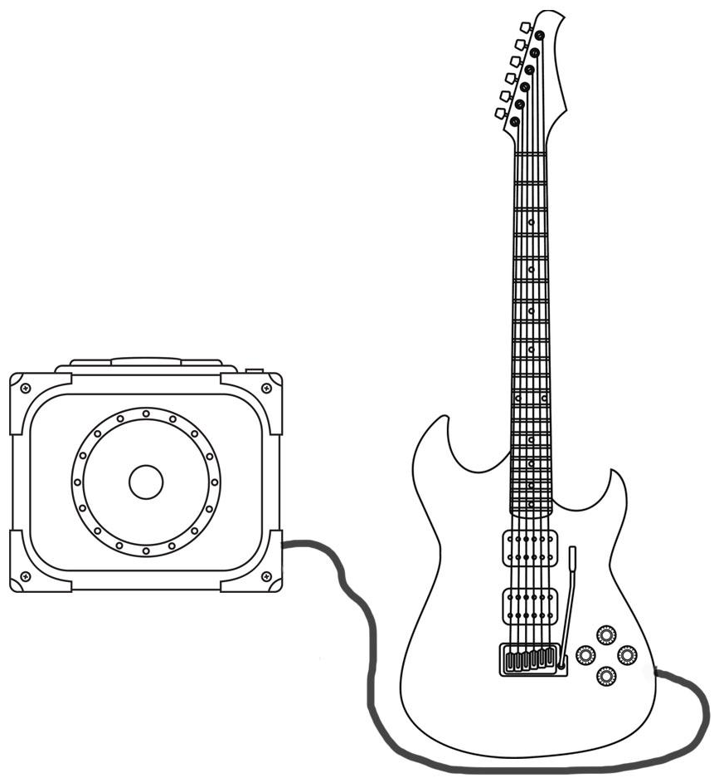
Electric Guitar
Strings vibrate and sound is created
Amplifier: Amplifies the sound and outputs sound from the speaker
Electric guitars have gadgets called pickups built into their bodies.
Pickups convert the vibrations of the strings to an electric signal. The electric signal is sent to an amplifier.
The amplifier converts the electrical signal into sound, and plays it.
Pickups convert vibration into an electric signal
Speaker
Shielded Cable

Slide 11
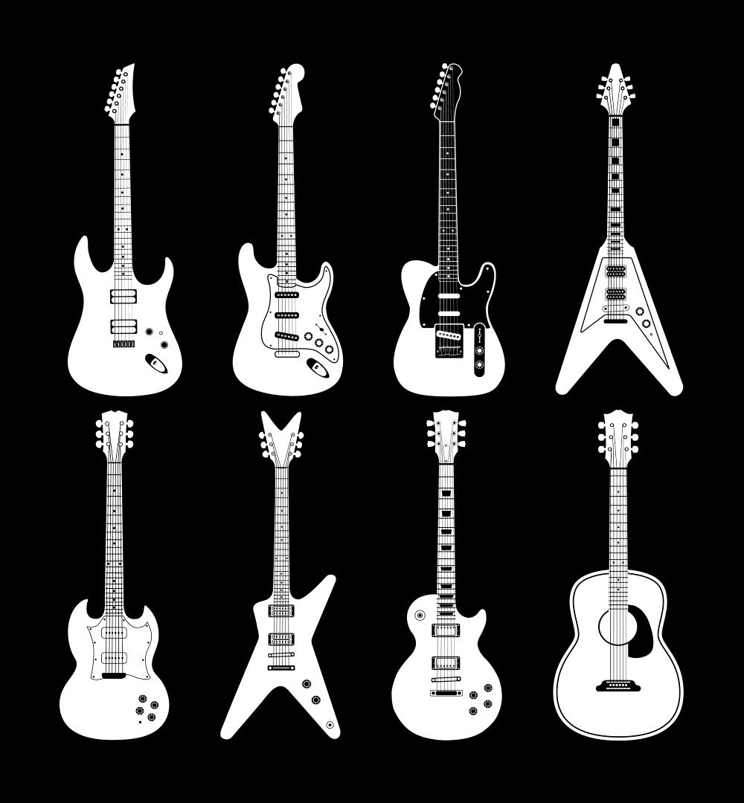
Electric Guitars
Since the sound of an electric guitar is not produced by the guitar body, they can be many different shapes!

Slide 12
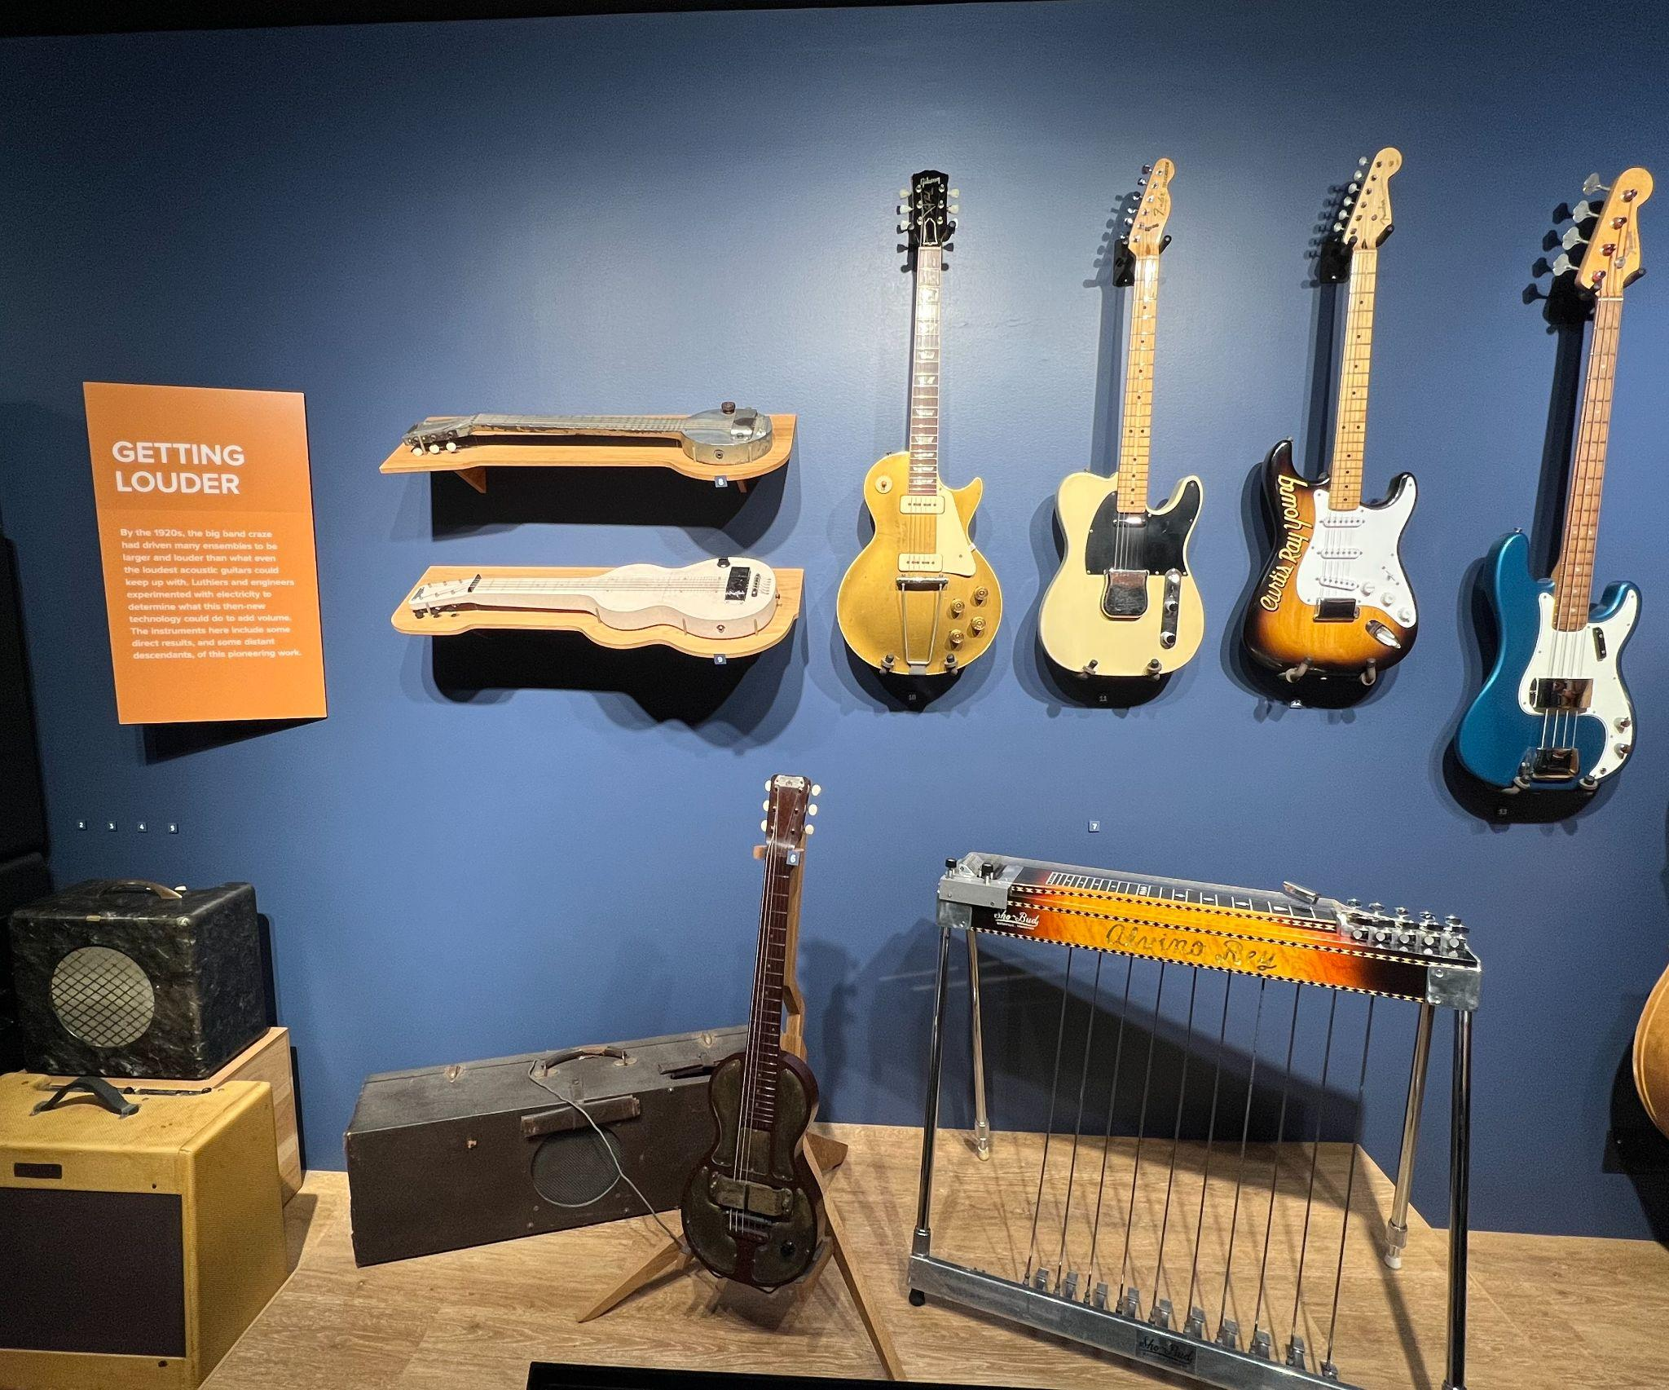
These are
electric guitars
from the
Museum of Making Music.

Slide 13
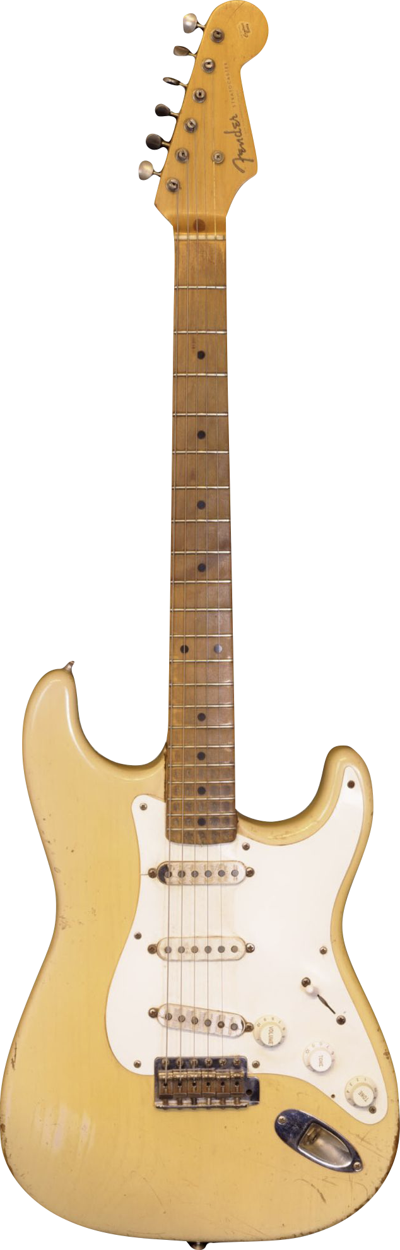
Let’s Identify:
Tuning Pegs
Pickup​
Strings​
Body​
Tuning Pegs
Strings
Pickup​
Body​

Slide 14

How does this guitar look and sound?

Slide 15


Slide 16

What about this one?

Slide 18
Create Your Own Guitar!
Now it’s time to design your own guitar! You can design a guitar of any shape and color you’d like but your sketch must include a pickup, strings, body, and tuning pegs.
When you are finished, complete the sentence at the bottom of the page in your worksheet.

Slide 19
Consider a Career in Music!
What careers are related to the lesson we just completed?
Luthier
Guitar Manufacturer
Designer
Acoustic Engineer
Retailer
Guitar Repair Tech
Electrical Engineer
Performer
Agent and/or Manager

Slide 20


